Slide 1
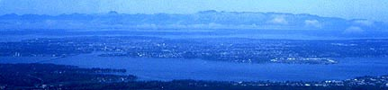
Review of King County’s Continuous Lake Temperature Monitoring Data
29th Annual Washington Lake Protection Association Conference
Curtis DeGasperi
King County Water and Land Resources Division
October 6, 2016
Notes:
Abstract
A number of aquatic ecosystem responses to changing climate have been documented in Lake Washington (Seattle, Washington) and other lakes around the world. These responses could only have been detected and understood in the context of climate change as the result of consistent long-term monitoring of physical, chemical, and biological components of the ecosystem. Further understanding of the effects of changing climate will come from continued comprehensive routine monitoring – specifically more frequent sampling (daily to sub-daily). In 2008 King County purchased 2 Endeco/YSI lake profiling systems, which are currently deployed on Lake Washington and Lake Sammamish. The systems are solar powered and equipped with meteorological stations and are capable of conducting up to 6 profiles per day recording temperature, conductance, dissolved oxygen, pH, chlorophyll fluorescence, and turbidity every meter from the surface to the bottom of the lake. A SQL database and web portal has been developed that provides public access to the data in near real-time (http://green.kingcounty.gov/lake-buoy/). Post-deployment calibration checks and automated range checking have been developed that also provide the public with information on the quality of data collected. The sub-daily profiling data, in conjunction with other components of King County’s lake monitoring program, will improve our understanding the response of these lake ecosystems to climate change – for example links between earlier onset of stratification and the timing and magnitude of the spring phytoplankton bloom.

Slide 2

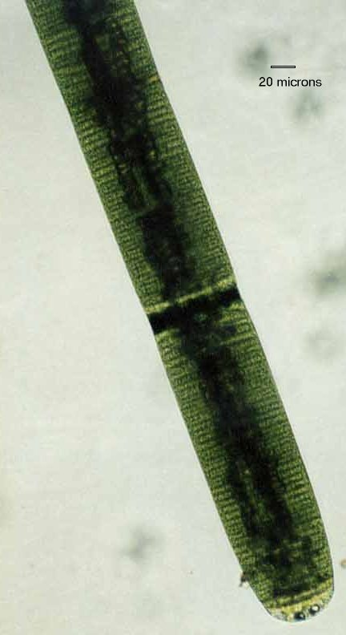

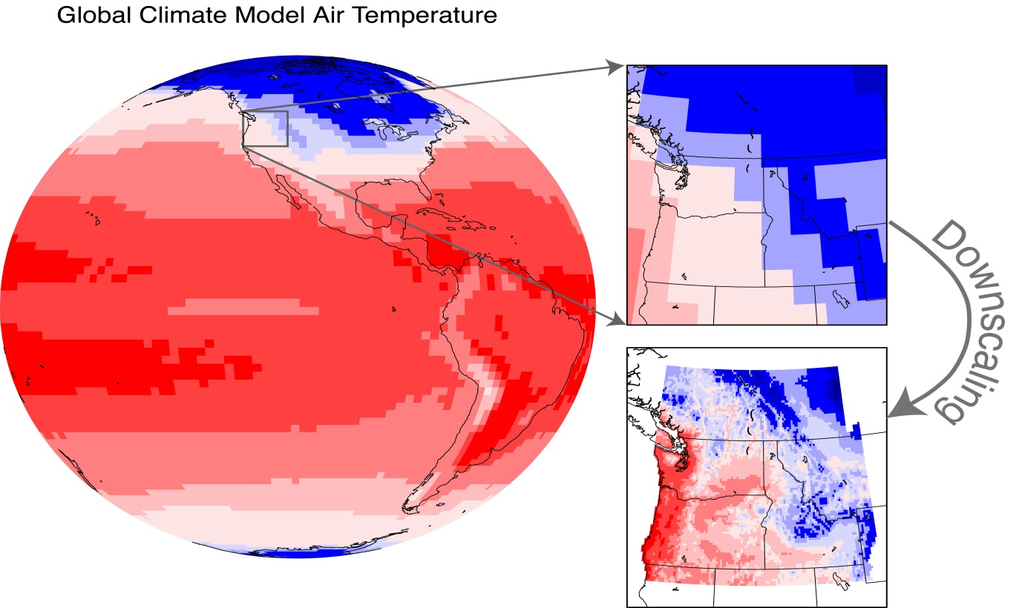

Why care about water temperature?
Distribution and abundance of organisms
Life history timing
Metabolic processes
Chemical reaction rates and gas fluxes

Slide 3
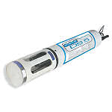

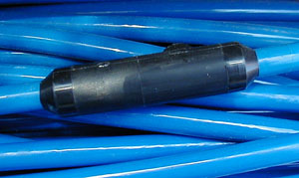
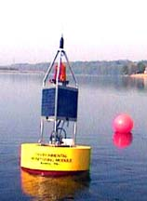
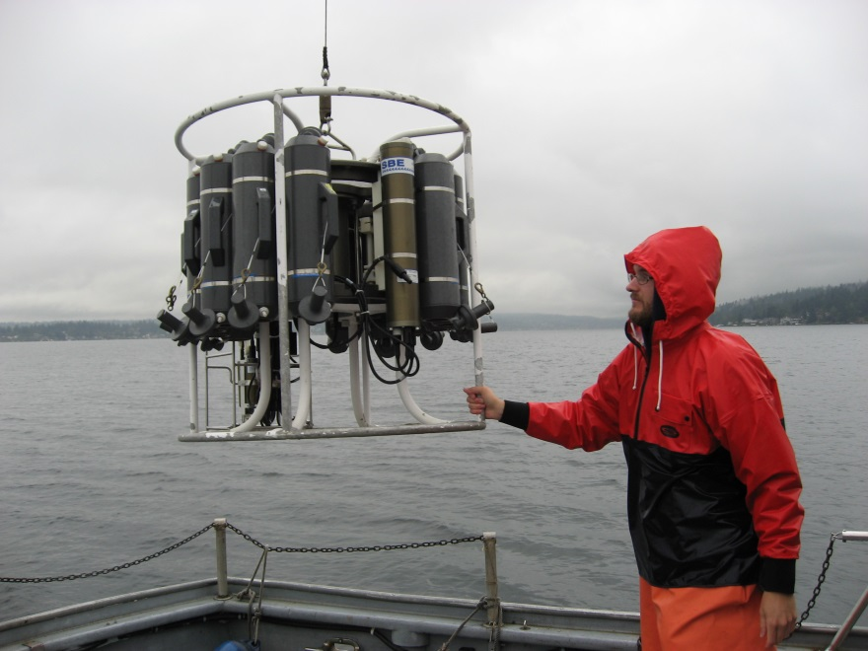
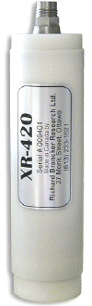
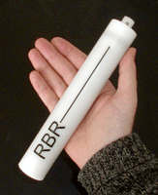
Various Temperature Monitoring Methods

Slide 4
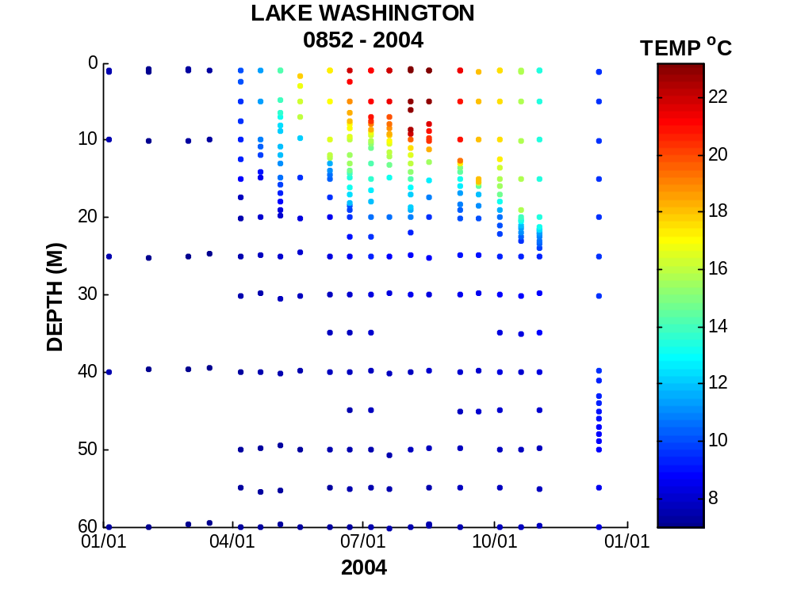
ROUTINE PROFILING WITH SONDE

Slide 5
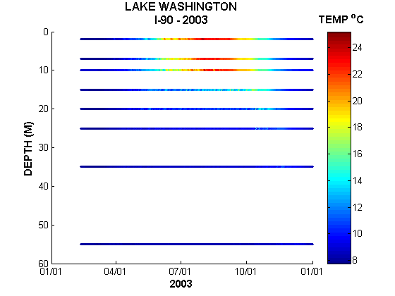
ONSET HOBOTEMP PRO THERMISTORS

Slide 6
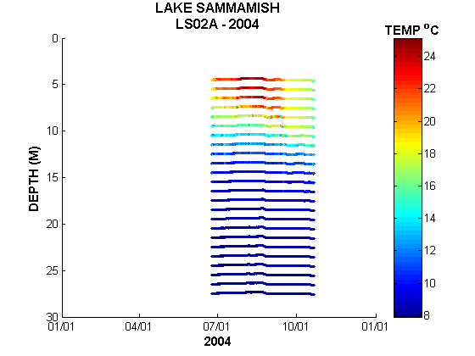
RBR THERMISTORS

Slide 7
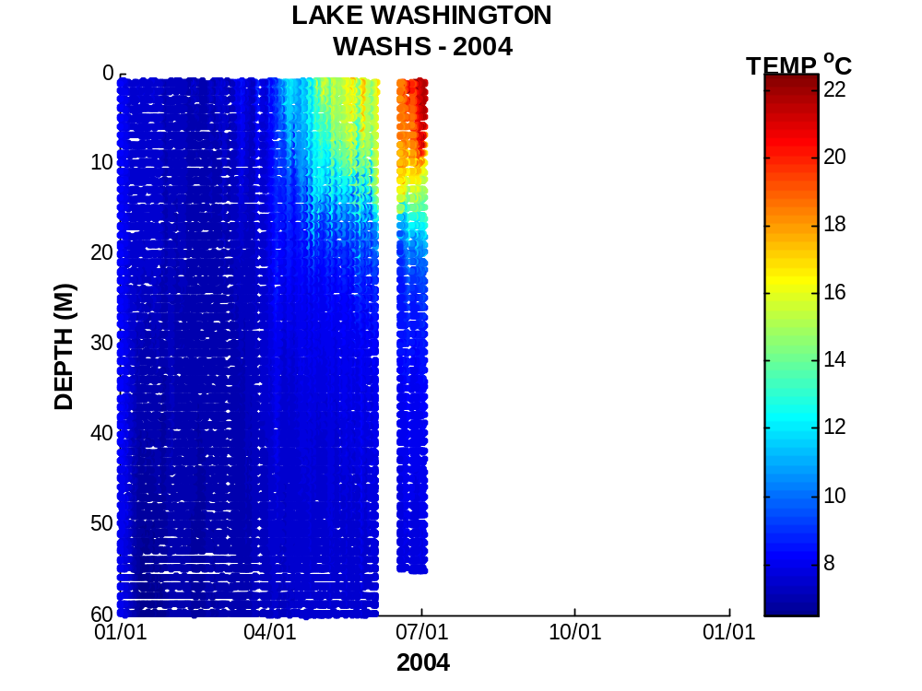
RUSS BUOY PROFILER

Slide 8
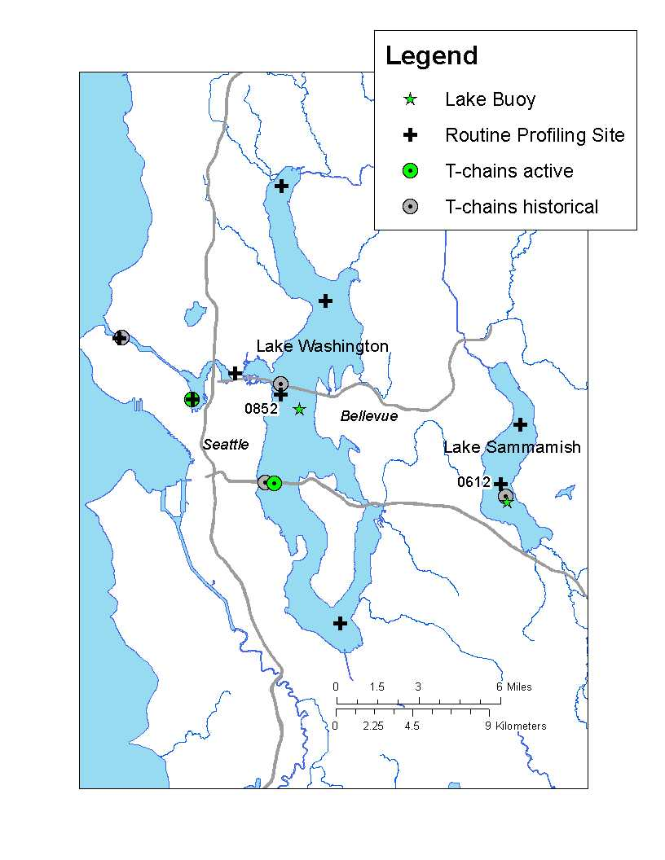
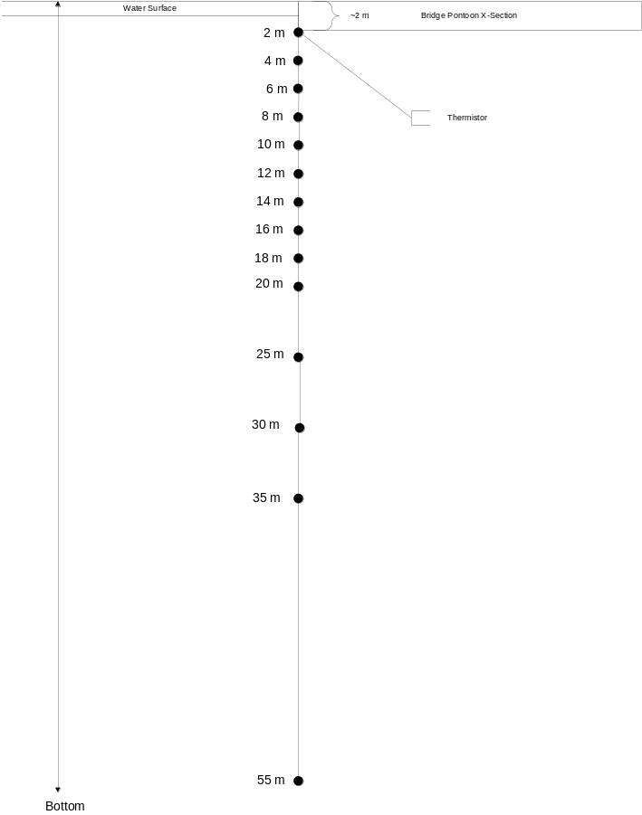
Locations
Notes:
Study area: Show audience that lakes we are talking about are just east of Seattle. A trip along I-90 heading east would cross Lake Washington and skirt the south end of Lake Sammamish.
Lake Washington is about 22 miles (35 km) long and has a maximum depth of ~214 ft (65.2 m)
Lake Sammamish is about 8 mi (13 km) long and has a maximum depth of ~105 ft (32 m)

Slide 9
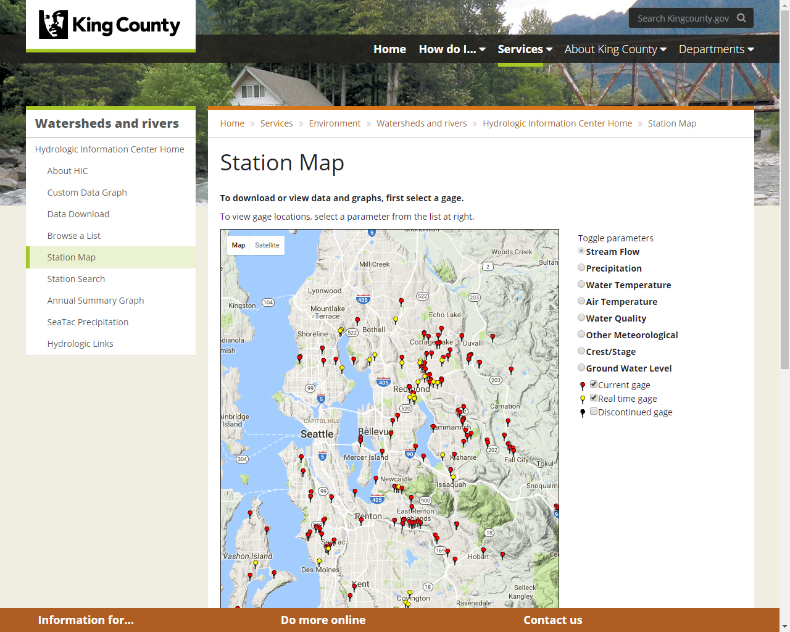
King County Hydrologic Information Center
Station Search:
0641
0852
0890
0522
0512
0890

Slide 10
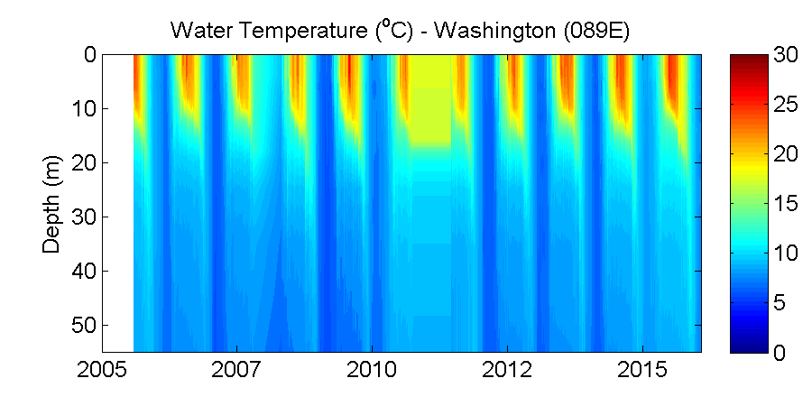
Lake Analyzer
Schmidt Stability
Thermocline Depth
Stratification Onset
Etcetera

Slide 11
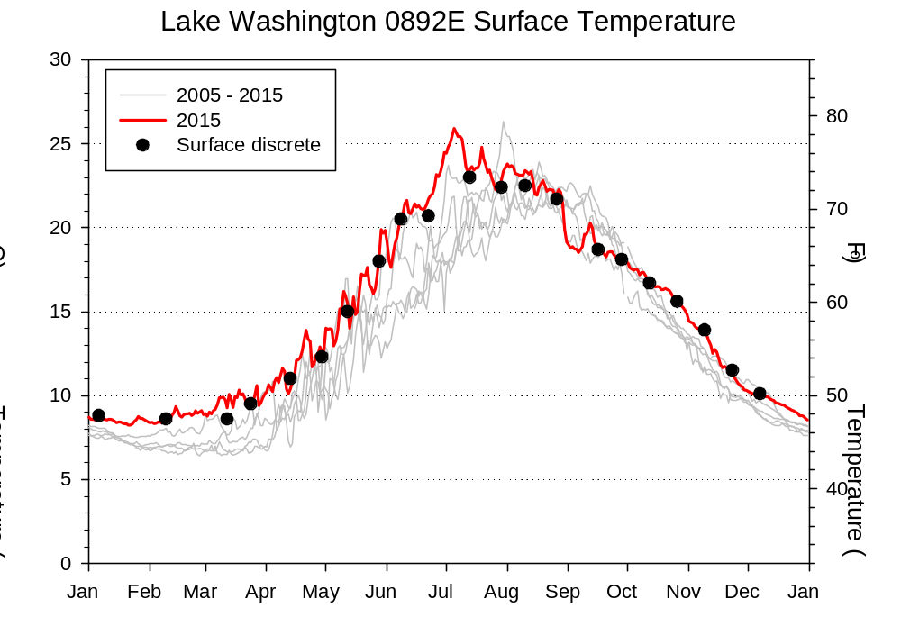
Year-to-year Comparisons

Slide 12
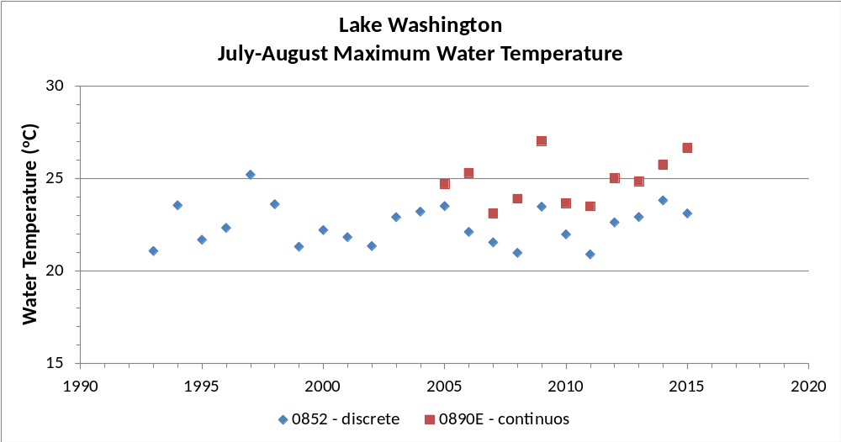
Trends in Summer Maximum Temperatures

Slide 13
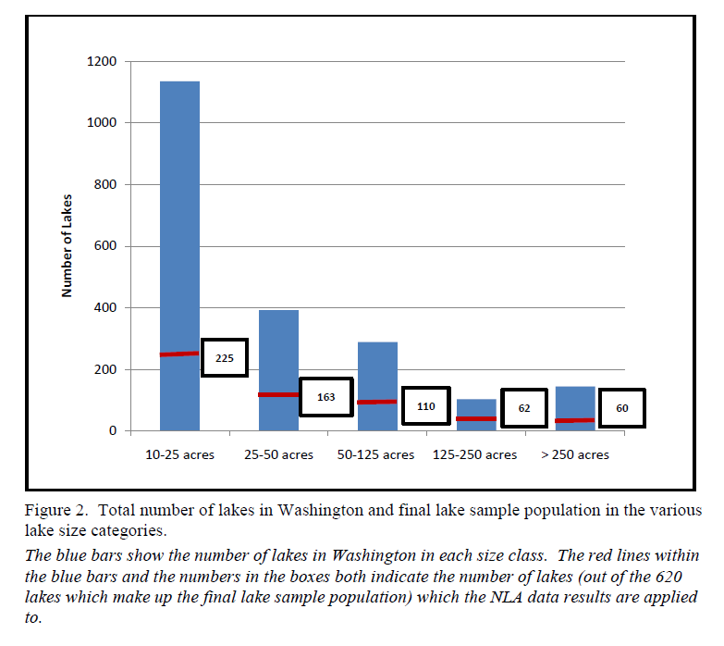
Continuous temperature monitoring may be even more important in small lakes
Bell-McKinnon (2010) Ecology Publication No. 10-03-029

Slide 14
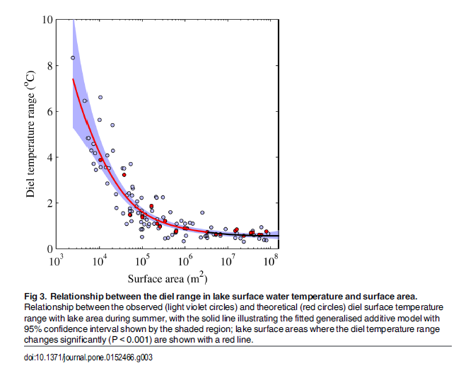
Diel temperature range appears to scale with lake area
~0.25 ~2.5 ~25 ~250~2500~25000 acres
0.001 0.01 0.1 1.0 10 100 km²
Woolway et al. (2016) PLoS ONE

Slide 15
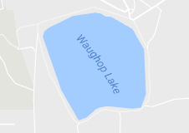
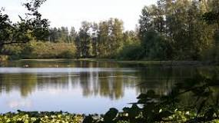
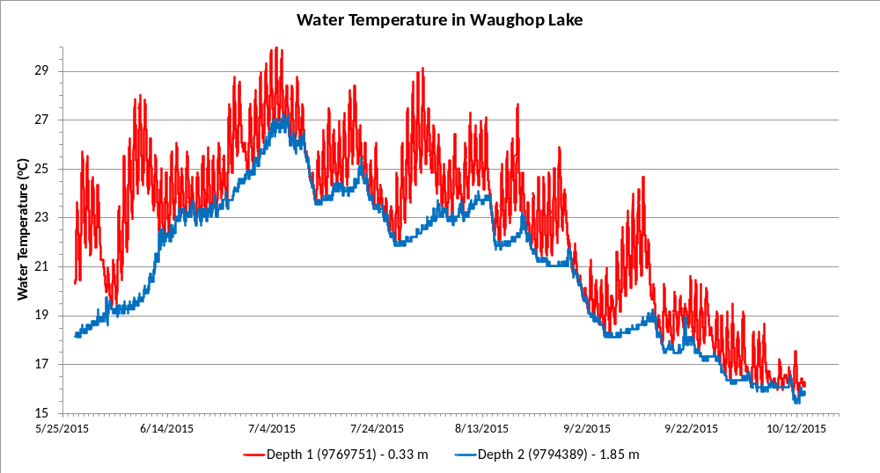
Waughop
Surface area: 33 ac (0.13 km²)
Mean depth: 7 ft (2.1 m)
Data courtesy of Jim Gawel, UW Tacoma

Slide 16
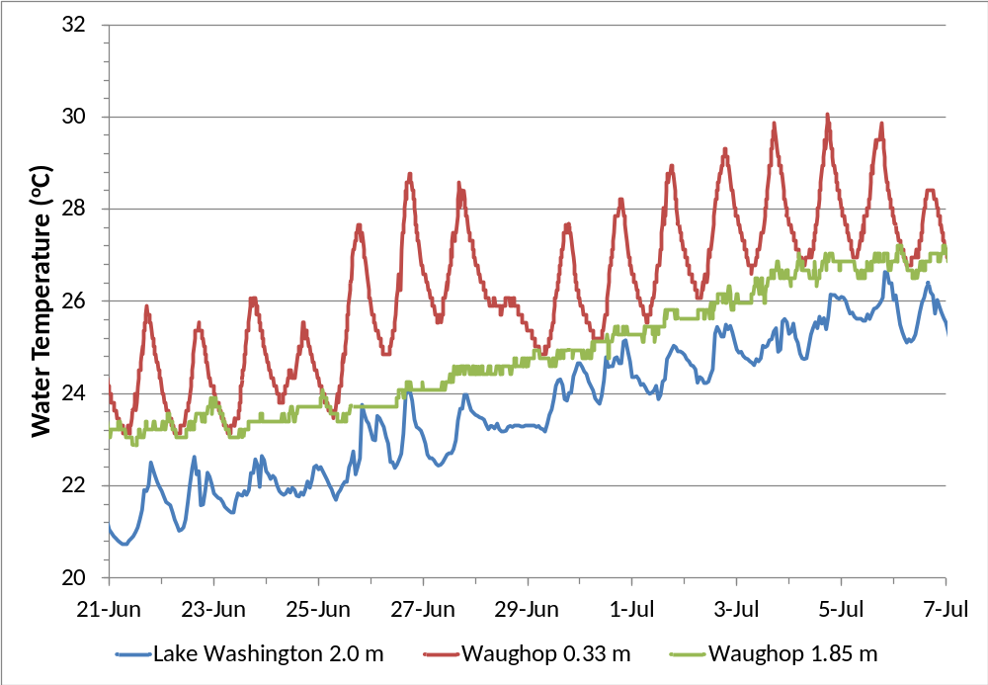
Compare Small vs Large Lake

Slide 17
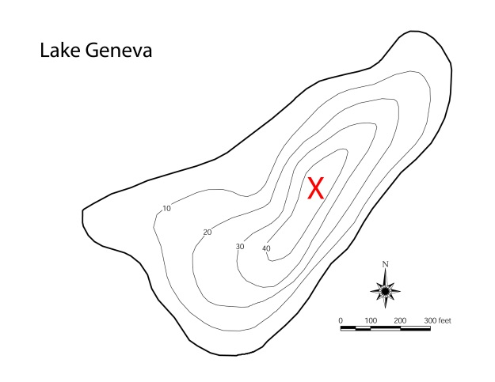
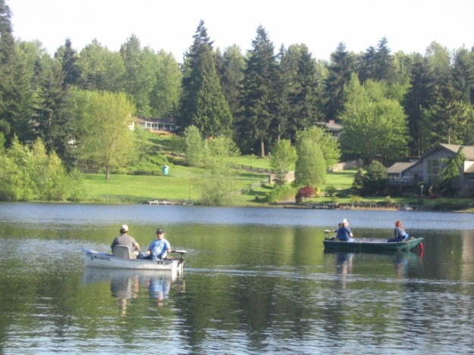
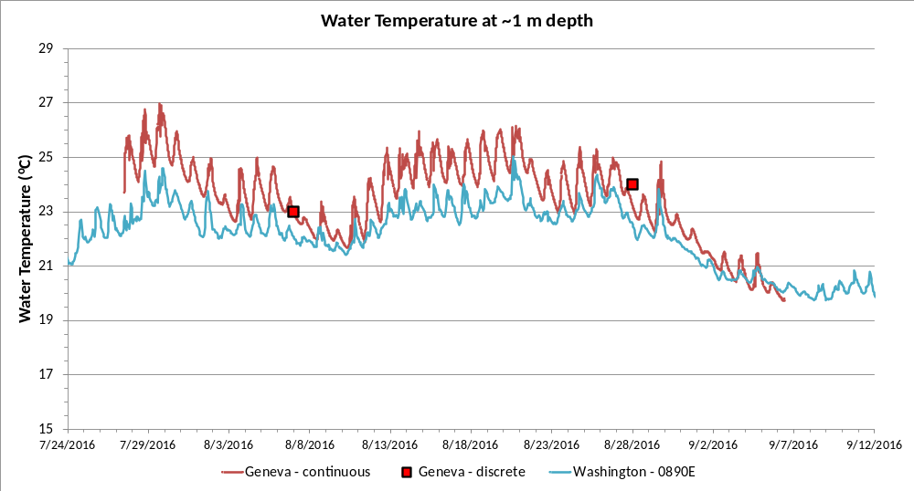
Lake Geneva
Surface area: 29 ac (0.12 km²)
Mean depth: 19 ft (5.8 m)

Slide 18
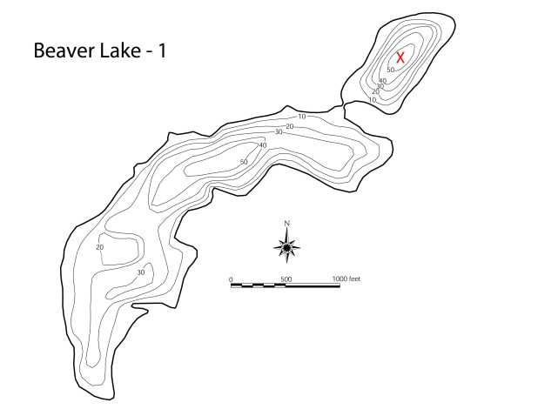
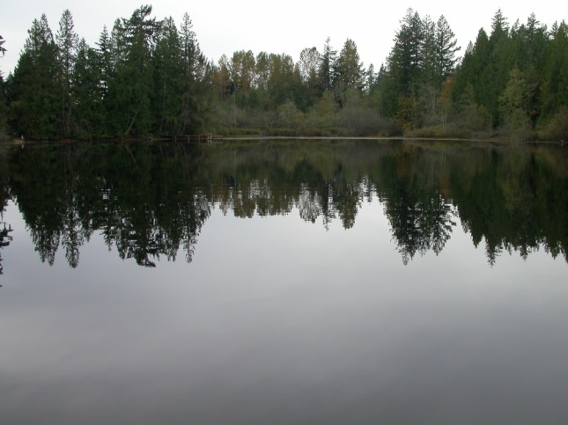
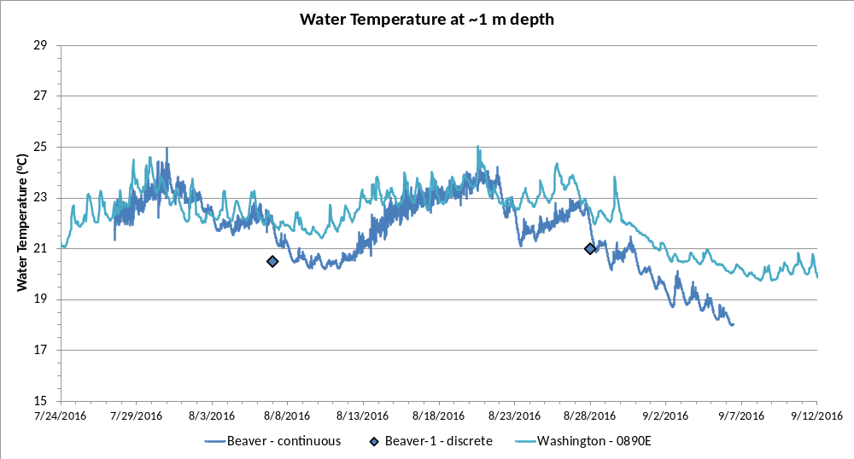
Beaver-1
Surface area: 12 ac (0.05 km²)
Mean depth: 22 ft (6.7 m)

Slide 19
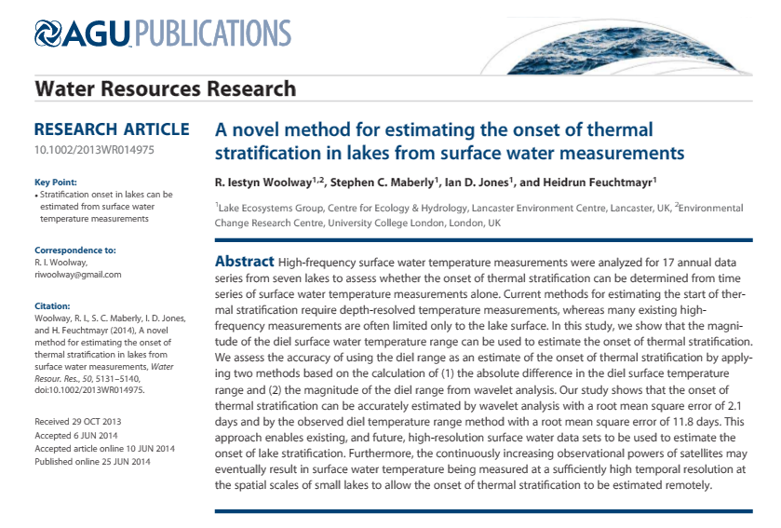
Estimating the timing of the onset of stratification

Slide 20
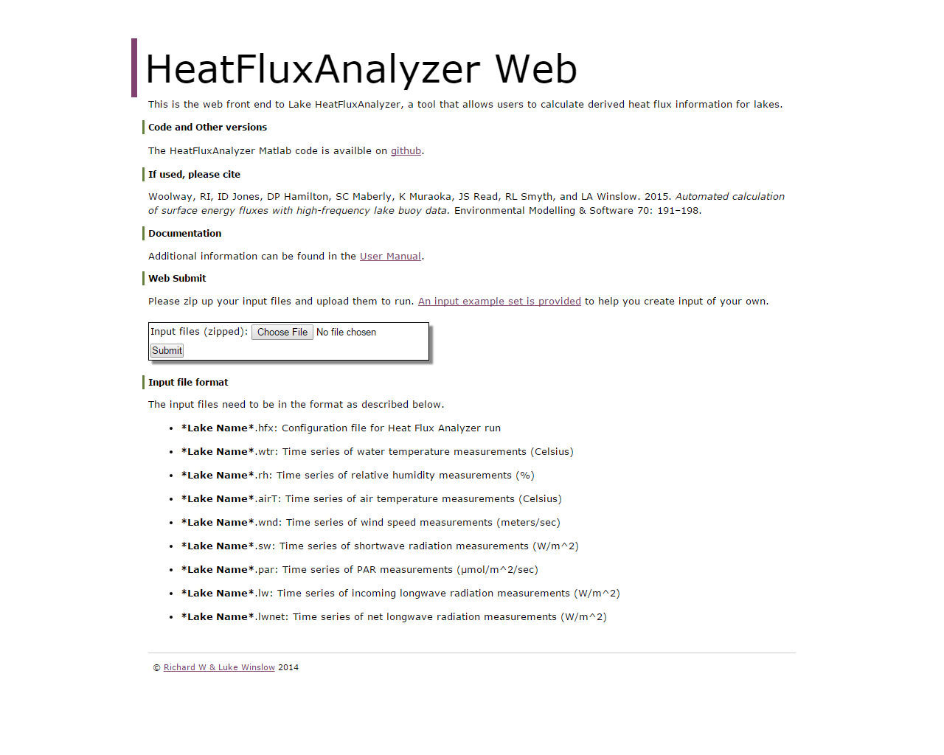
http://heatfluxanalyzer.gleon.org/

Slide 21
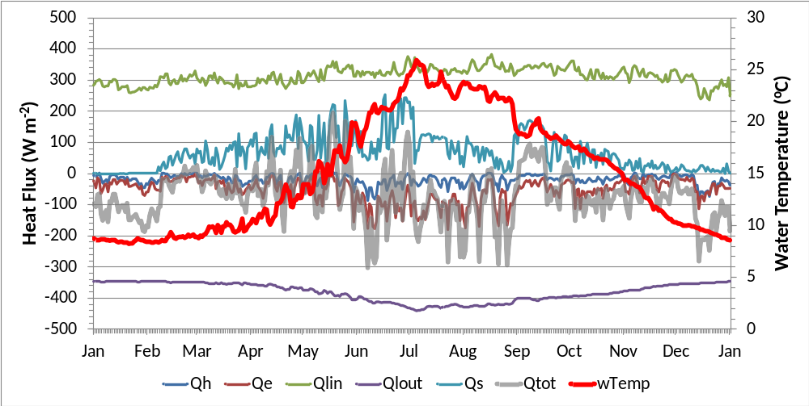
Estimated Heat Fluxes
Lake Washington – 2015
Heat Flux (Qtot) = Solar (Qs) + Incoming Longwave (Qlin)
– Outgoing Longwave (Qlout) – Evaporation (Qe) – Conduction (Qh)

Slide 22

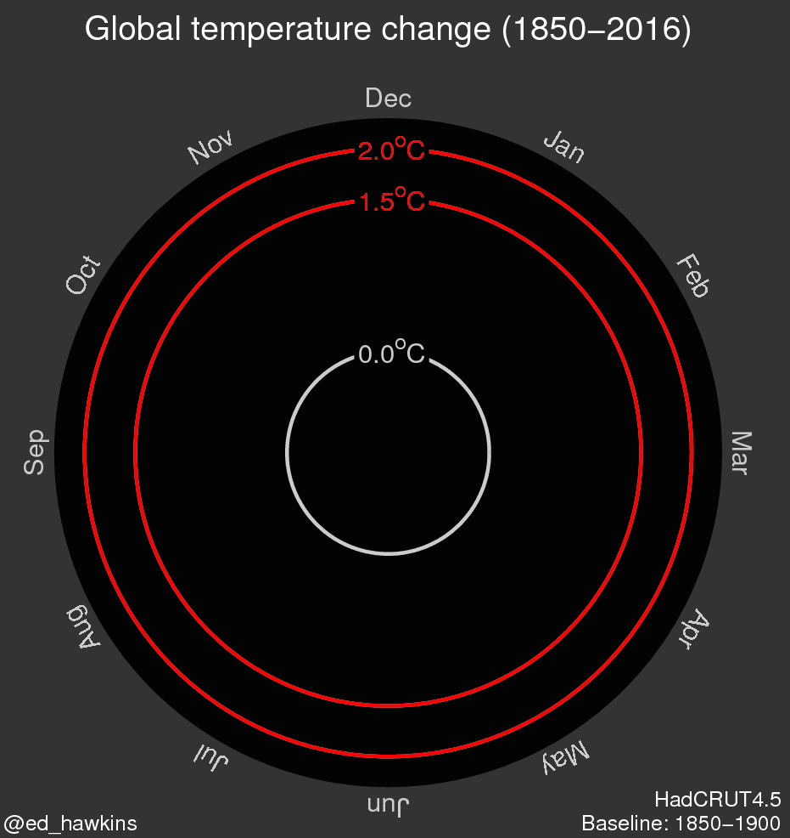
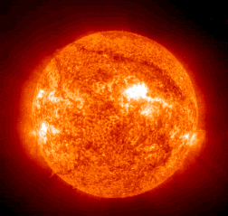
A couple of conclusions…
High resolution temperature data may be needed if…
You may just need a single sensor near the lake surface

Slide 23
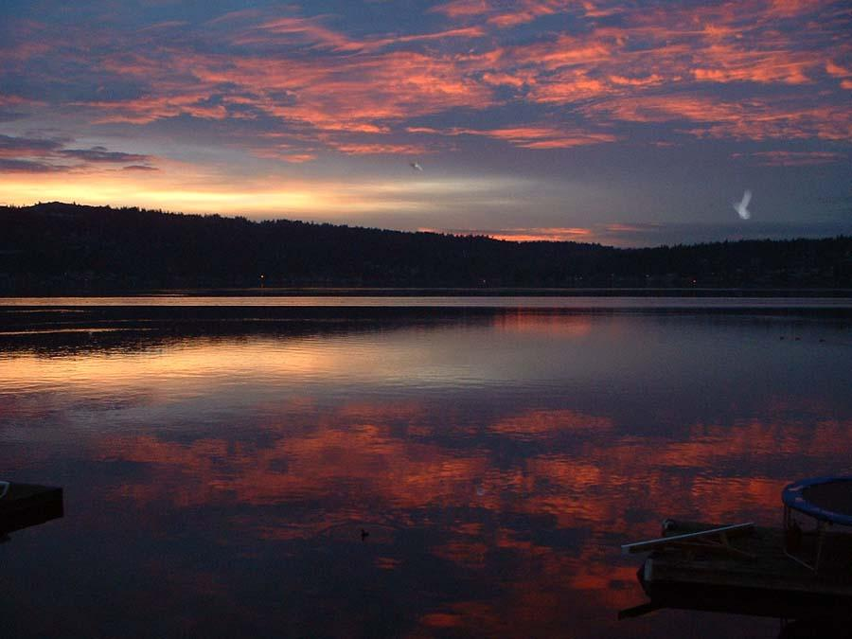
Questions?

Slide 24
Some references
Rode et al. (2016) Sensors in the stream: The high-frequency wave of the present. ES&T doi:10.1021/acs.est.6b02155.
Woolway et al. (2016) Diel surface temperature range scales with lake size. PLoS ONE doi:10.1371/journal.pone.0152466.
Woolway et al. (2015) Automated calculation of surface energy fluxes with high-frequency lake buoy data. Env. Model. & Soft. doi:10.1016/j.envsoft.2015.04.013
HeatFluxAnalyzer Web http://heatfluxanalyzer.gleon.org/
Woolway et al. (2014) A novel method for estimating the onset of thermal stratification in lakes from surface water measurements WRR doi:10.1002/2013WR014975.
Read et al. (2011) Derivation of lake mixing and stratification indices from high-resolution lake buoy data. Env. Model. & Soft. doi:10.1016/j.envsoft.2011.05.006.

